Slide 1

SELF PRODUCTED MOVIE WITH VFX
Students:
Bui Thai Son– 20233874
Pham Huy Hoang– 20233850
Le Duy Duc– 20233838
Supervisors: Assoc. Prof. Pham Van Tien
Assoc. Prof. Tran Thi Thanh Hai

Slide 2
Outline
Introduction
Design process
Limitations
Conclusions

Slide 3
Introduction
Brief overview of the project: Making a short-movie with the help of Blender software and editor software
Motivation: Blend creativity and integrating visual effects. It’s a journey of skill development, as mastering VFX tools enhances both technical and artistic capabilities
Objectives: Know how to design and create a short-movie with the help of Blender

Slide 4
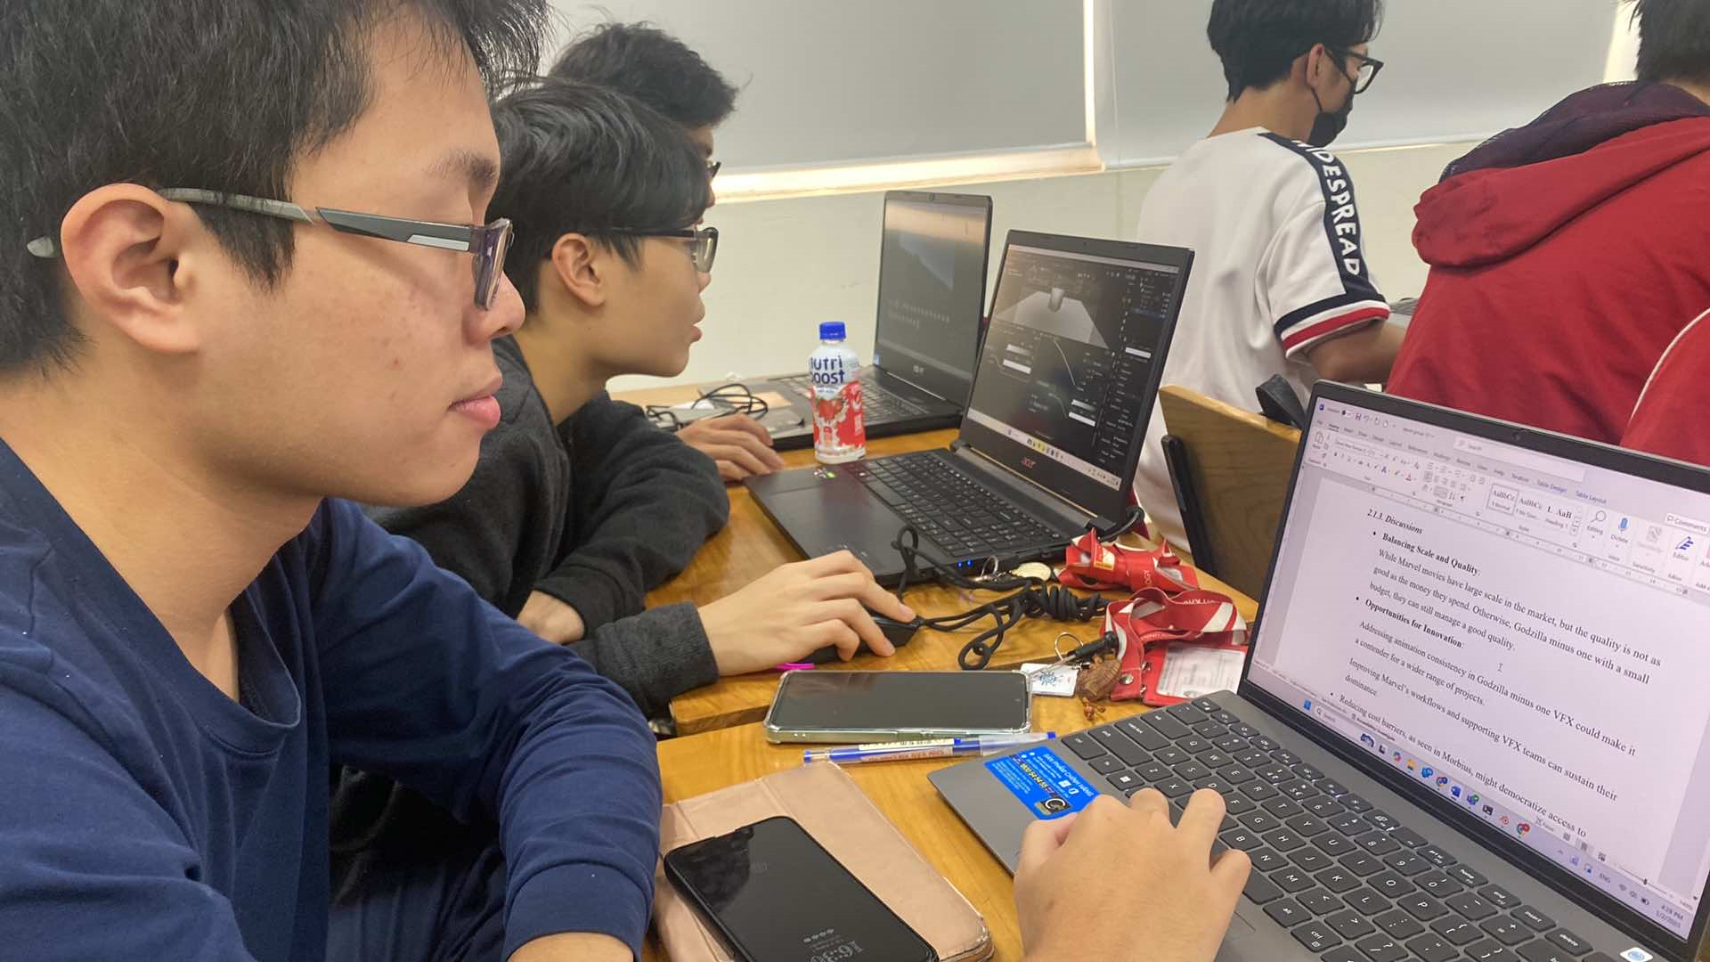
Team building
We have severals meeting to create our plan and script for the trailer
This meeting is try to fix the script

Slide 5
Step 1: User requirements
Observations: +) Pursose: Observe real-world workflows and problem-solving techniques in VFX production.
+) Focus: Identify inefficiencies, bottlenecks, and best practices in the pipeline.
Questionnaires: +) Rate the importance of the following tools in your VFX
+) Which aspect of VFX production causes the most delays.

Slide 6
Step 2: Specification
Using Figma to create plan, script, divide task for members, gather source for project, references,…
Blender ver4.2 to create environment for the scenes, keyframing for camera.
Adobe Premiere Pro to composing all together to make an output: a short-movie(trailer)

Slide 7
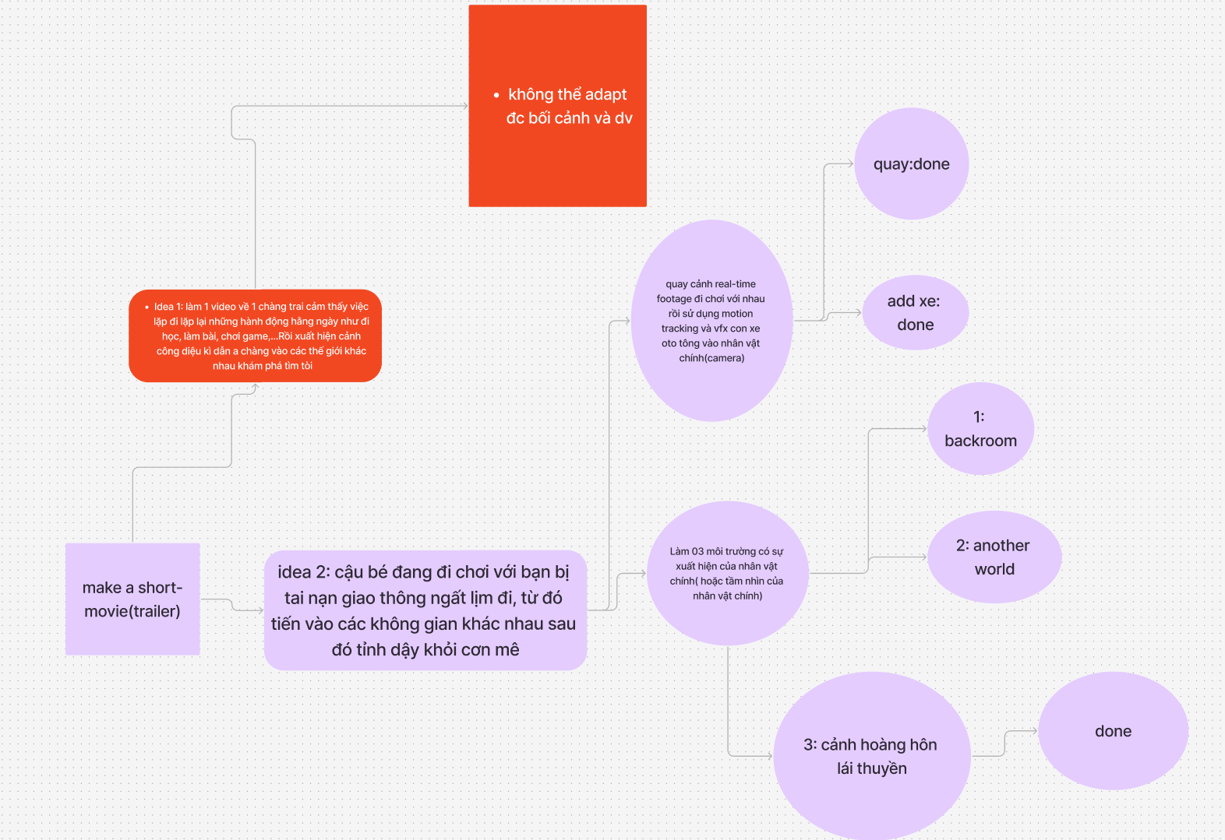
Step 3: Planning
Basic planning for our porject

Slide 8
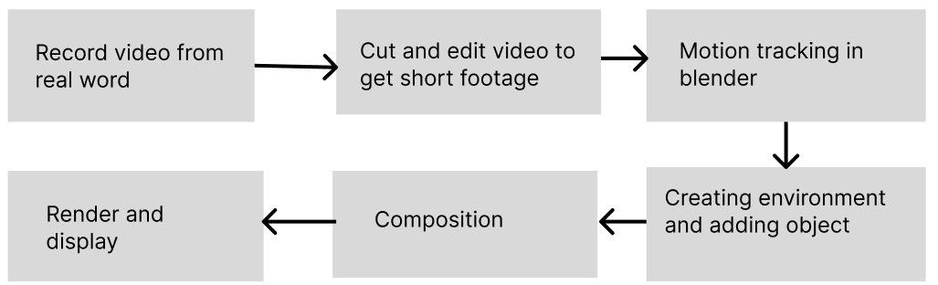
Step 4: Block design

Slide 9
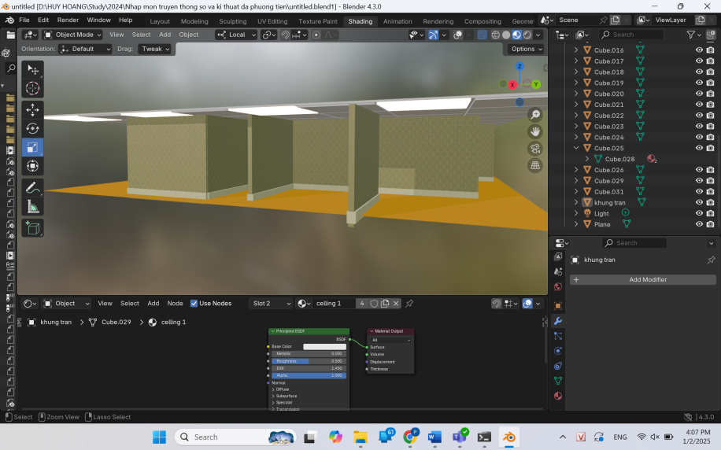
Step 5: Detail design
Environment 1: The Backroom
Create wall, floor and ceiling from basic square cubes,..
Applying light effect for the bulbs
Adding texture to the wall and the floor

Slide 10
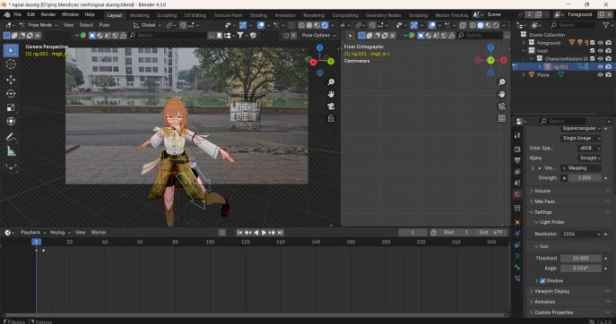
Step 5: detail design
Environment 2: Motion tracking
Use add-on autotracker to track every detail
Adding model, solve shadow with HDRI picture for the environment

Slide 11
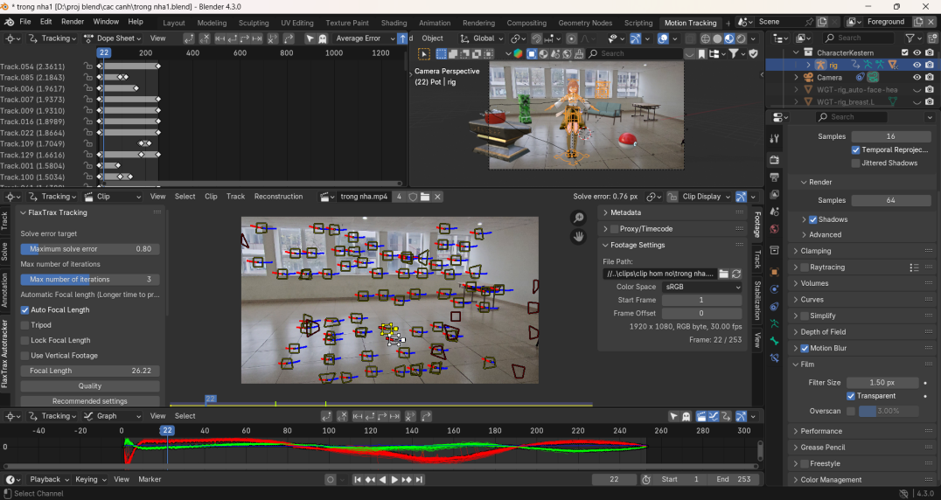
Step 5: Detail design
Environment 2: Motion tracking
Use add-on autotracker to track every detail
Adding model, solve shadow with HDRI picture for the environment

Slide 12
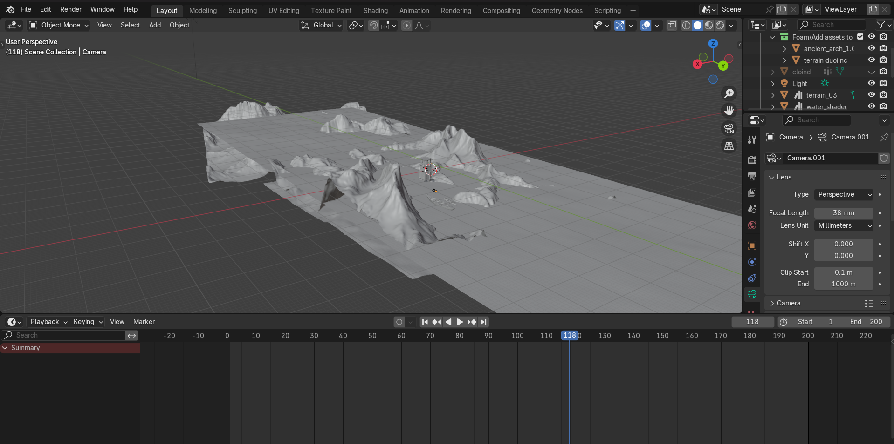
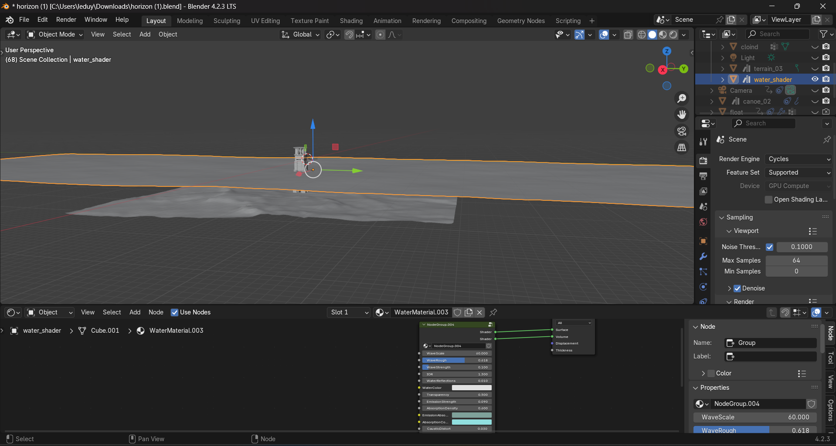
Step 5: Detail design
Environment 3: Geeks and horizon
Using add-ons for object and water
Adding mountains
Keyframing object moving on the sea

Slide 13
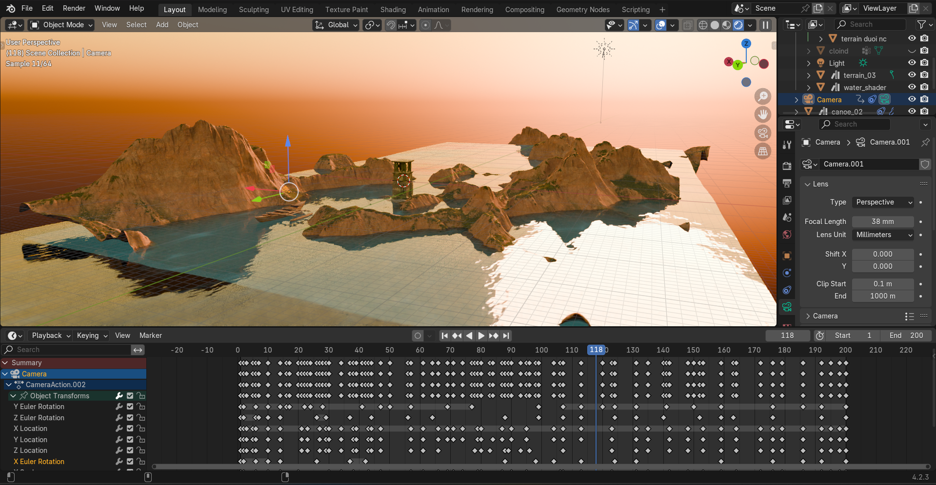
Step 5: Detail Design
Environment 3: Geeks
and horizon
Create sun, shadow, light reflex, moving object, create wave for water

Slide 14
Step 6: Select the best altenatives
Maya
Unity
Adobe After effect

Slide 15
Step 7: Testing
The render works well
Got no damage in our project

Slide 16
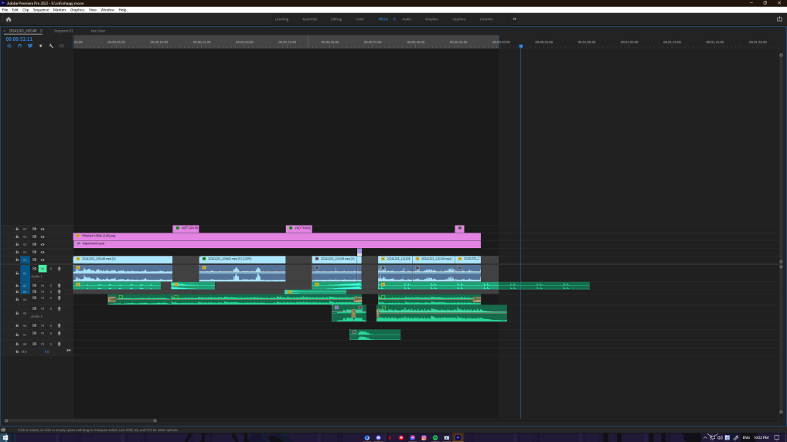
Step 8: Manufacture
About 70% of our project

Slide 17
Limitations
Lacks of skill in blender(major issue)
Not having a specific guideline for project so the work sometime out of the line
Let our mind fly too high that so many idea come in so that hard to make a script

Slide 18
Conclusions
Making a self-producted movie is challenging for newbies like us, we still faced with many troubles
However, we will pushing ourselves to make a great output

